Slide 1
Improving London’s air quality
Joanne McCartney
Deputy Mayor of London
1st June 2016

Slide 2
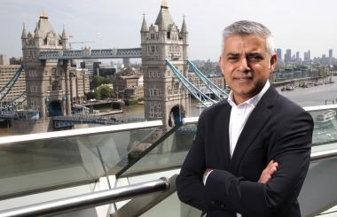
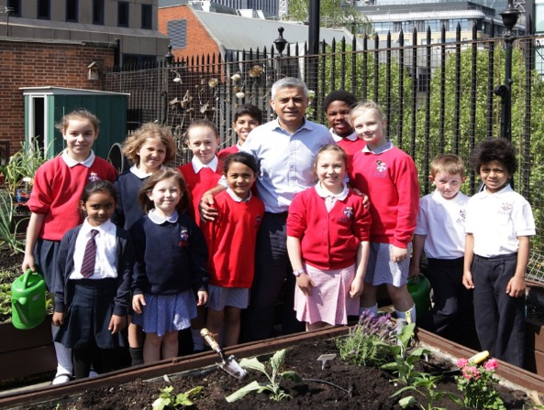
A new Mayor…
Sadiq Khan was elected Mayor of London on 5 May 2016
Clear mandate to improve London’s air quality
Has identified air quality as London’s biggest environmental challenge
Manifesto set out desire to do a bigger and/or sooner Ultra Low Emission Zone amongst many other measures
Made a major policy announcement on air quality on Friday 13th May 2016…

Slide 3
Why is air quality so important?
Public Health
In 2015 the GLA published it’s assessment of the combined health impacts of particulate matter (PM_{2.5}) and nitrogen dioxide (NO₂). This estimated that the equivalent of 9,500 deaths were caused by long-term exposure to air pollution.
A baby born in London in 2010 who was exposed to 2010’s air quality for its entire life would lose 2.2 years (if male) and 2 years (if female) of life expectancy.
Fairness
The health impacts associated with air pollution fall disproportionally on our most vulnerable communities, affecting the poorest and those from minority ethnic groups more acutely. Tackling air pollution is about social justice and there is an urgent need to do more to tackle public health inequalities.
Legal compliance
Like most major European cities, London does not meet the legal requirements for some pollutants (mainly Nitrogen Dioxide (NO₂) but issues remain with Particulate Matter).

Slide 4
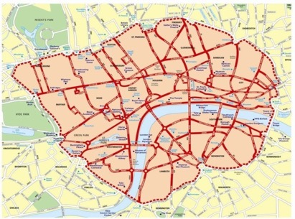
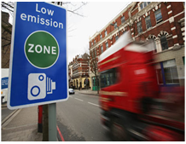
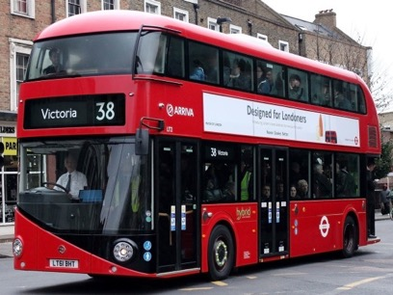
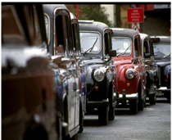
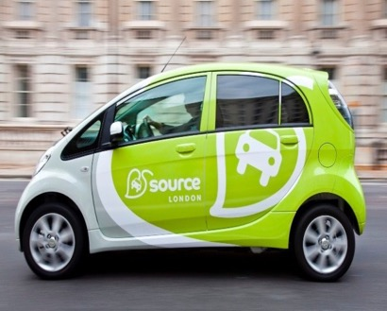
Solutions
Congestion charge
Low Emission Zone
Buses
Taxis
Cycling
Electric cars

Slide 5
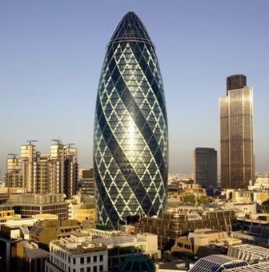
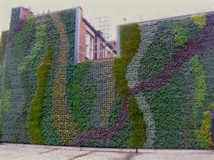
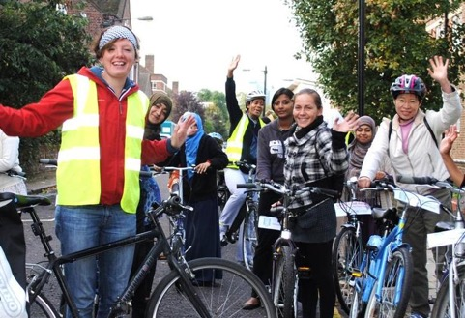
Solutions
Air Quality Neutral
Retrofit programmes
Construction
Local measures
Mayor’s Air Quality Fund
Health and comms

Slide 6
Recent trends in London’s air quality
NO₂ 2010
NO₂ trend 2000-2015
NO₂ 2013
PM₁₀ trend 2004-2015
NO₂ 2015

Slide 7
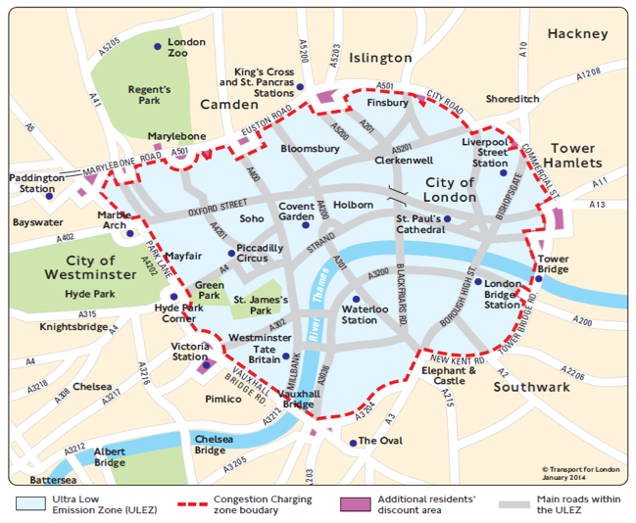
Why an Ultra Low Emission Zone?
Previous Mayor adopted ULEZ to tackle air pollution in central London, which was expected to remain an air quality focus area beyond 2020
Greatest amount of public exposure and highest emissions occur here
Congestion Zone is established with embedded travel behaviour and enforcement
An opportunity to promote and encourage use of ultra low emission vehicles by building on existing Ultra Low Emission Discount
A driver to transform TfL services

Slide 8
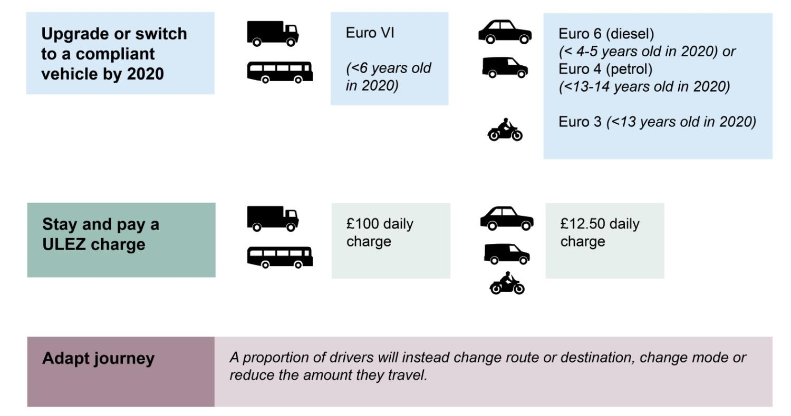
ULEZ standards

Slide 9
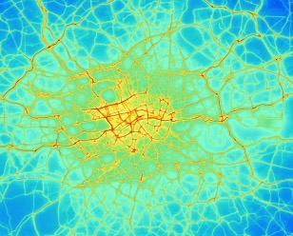
London’s Ultra Low Emission Zone
Significant reduction in emissions from Ultra Low Emission Zone
ULEZ significantly expedites London’s NO₂ compliance
But still did not achieve compliance
Government’s National Air Quality Action Plan assumed 2025 as compliance date
The full ULEZ package would reduce total vehicle NO_{x} by 49%, PM₁₀ / PM_{2.5} 64% and CO₂ by 15% in central London.
Breakdown of NO_{x} savings according to vehicle type...

Slide 10
Mayor’s announcement
Ultra Low Emission Zone and other charges
Extending the Ultra-Low Emission Zone (ULEZ) to the North Circular Road and the South Circular Road and the possibility of bringing forward the introduction earlier than 2020. Under current plans the ULEZ will only operate within the Congestion Charging Zone and it is due to come in from 2020.
Implementing an extra charge on the most polluting vehicles entering central London using the Congestion Charge payment and enforcement system from 2017 (this would not mean an increase in the Congestion Charge but just the method for collecting the extra charge from people driving the most polluting vehicles)
Introducing ULEZ standards for heavy vehicles London-wide from 2020
To balance and mitigate effects the Mayor has also called on Government to implement a national diesel scrappage scheme

Slide 11
Mayor’s announcement
TfL to lead by example
Introducing self-imposed ULEZ standards a year earlier for TfL double decker buses
Implementing clean bus corridors – tackling the worst pollution hotspots by concentrating cleaner buses on the dirtiest routes
Expanding the ULEZ retrofit programme to 3,000 buses outside the central zone (up from 2,000)
Purchasing only hybrid or zero-emission double-decker buses from 2018.

Slide 12
Mayor’s announcement
Next steps
Formal policy consultation to begin in a matter of weeks.

